Slide 1
Probability
CS 131: Discrete Structures - Section # 17821
BY Gerardo Espinoza Garcia

Slide 2
The Origin of Probability Theory
Dating back to 1526, Italian mathematician, physician, and gambler Girolamo Cardano is credited with writing the first book on the subject of probability called Liber de Ludo Aleae (Book on Games of Chance).
Forwarding into the seventeenth century, a gambling dispute between two French mathematicians Blaise Pascal and Pierre de Fermat led them to study the odds of a dice when rolled repeatedly.
In the eighteenth century French mathematician Laplace defined probability as the number of successful outcomes divided by the number of possible outcomes.

Slide 3
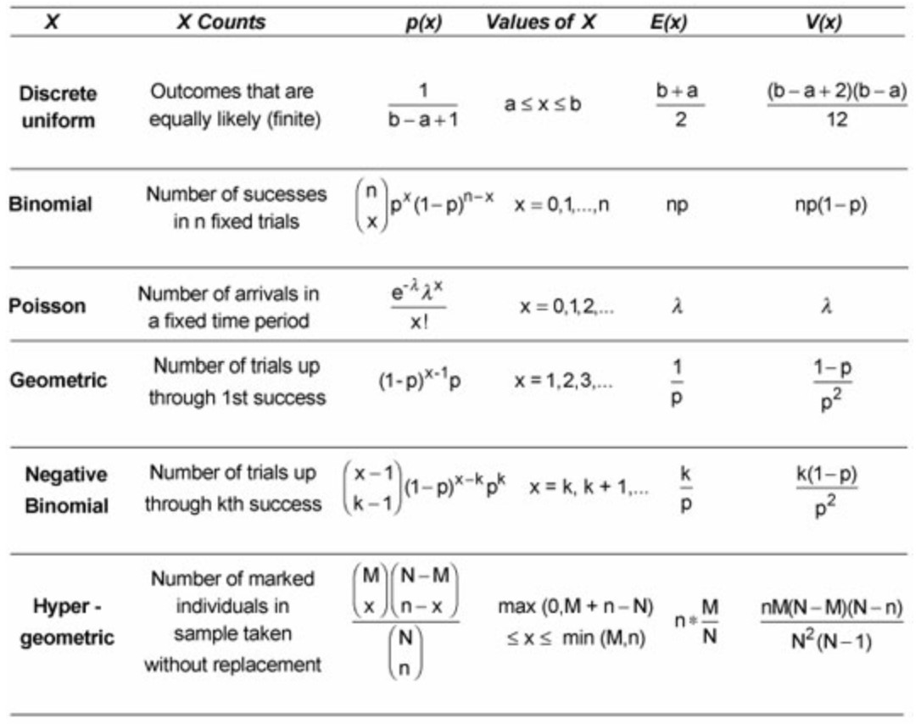
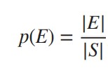
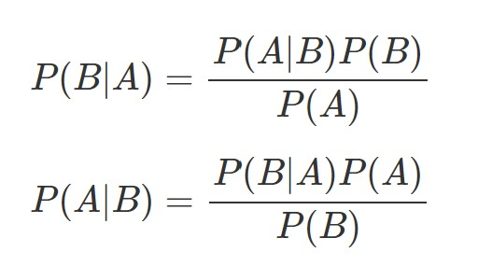
Equations
Discrete Probability Distributions
Laplace:
Bayes:
Notes:
Laplace: General Definition (Probability of an event)
|E|=The number of successful outcomes
|S|= The number of total outcomes
Bayes Theorem: Probability of an event based on conditions related to the event (Conditional Probability)
(A|B) = events
P(A|B) = probability of A given B is true
P(B|A) = probability of B given A is true
P(A),P(B) = the independent probabilities of A and B

Slide 4
Why is Probability important?
Despite starting with the purpose of studying gambling, The uses of probability has evolved.
Meteorologists: use patterns to predict the probability of rain
Genetics: understand the inheritance of traits
Winning the lottery
Smart phones: constantly suggest words to use
Dying: car crashes, airplanes, etc.
Computer Science

Slide 5
Probability in Computer Science
Probabilistic Algorithms
Monte Carlo Algorithm - A randomized algorithm with a fixed running time which does not always give a correct answer.
Las Vegas Algorithm - A randomized algorithm without a fixed running which always gives a correct answer.
Computer Hardware
Databases
Network and Systems
Notes:
Monte Carlo - guesses answer (can be incorrect but most likely correct)
Las Vegas - always correct but time is always in question

Slide 6
Conclusion
In Conclusion Probability is a part of our daily lives. Moreover, as a student in computer science is crucial to understand and best implement probability when it is needed in the tasks at hand.

